Slide 1

Pi Approximation Using MPI
Second Project Presentation for
CS 8172 –Parallel-Distributed Computing-Fall 2025
Md Jahirul Islam
001120708
Kennesaw State University
Course Instructor
Dr. Bobin Deng

Slide 2
Presentation Outline
Introduction 3
Experimental setup 5
Methodology 6
Result analysis 8
Conclusion 12

Slide 3
Introduction
What is MPI
Message Passing Interface (MPI) enables distributed parallel computing by allowing processes to communicate through message passing
MPI_COMM_WORLD
Process 1
Process 2
Process n
CPU
Memory
CPU Memory
CPU
Memory

Slide 4
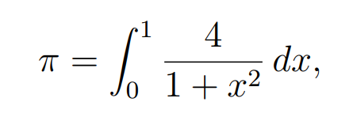
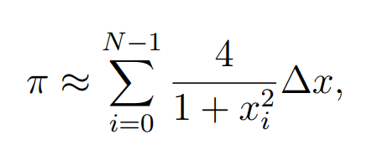
Introduction (Problem Statement)
Approximate the value of π as a sum of rectangles
Sequential program is slower as the number of steps NUMSTEPS increases.
Two MPI-based parallel versions:
  Version 1: Uses MPI_Reduce for efficient aggregation.
  Version 2: Uses MPI_Bcast and MPI_Gather for explicit data distribution and collection
Goal: Compare accuracy, scalability, and execution time.

Slide 5
Experimental setup
Two Versions of solution Reduce, and Broadcast + Gather
Number or processes = 4
Numsteps = 10³, 10⁴, 10⁵, 10⁶,…10¹²

Slide 6
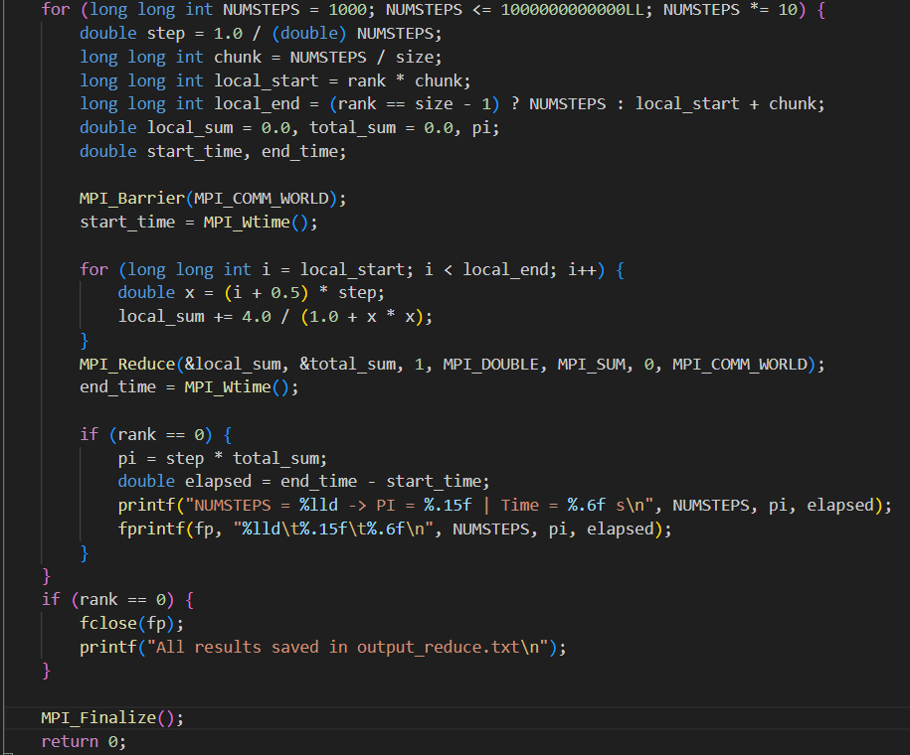
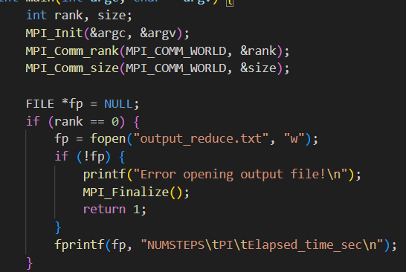
Methodology
Pi_Reduce Code explanation

Slide 7
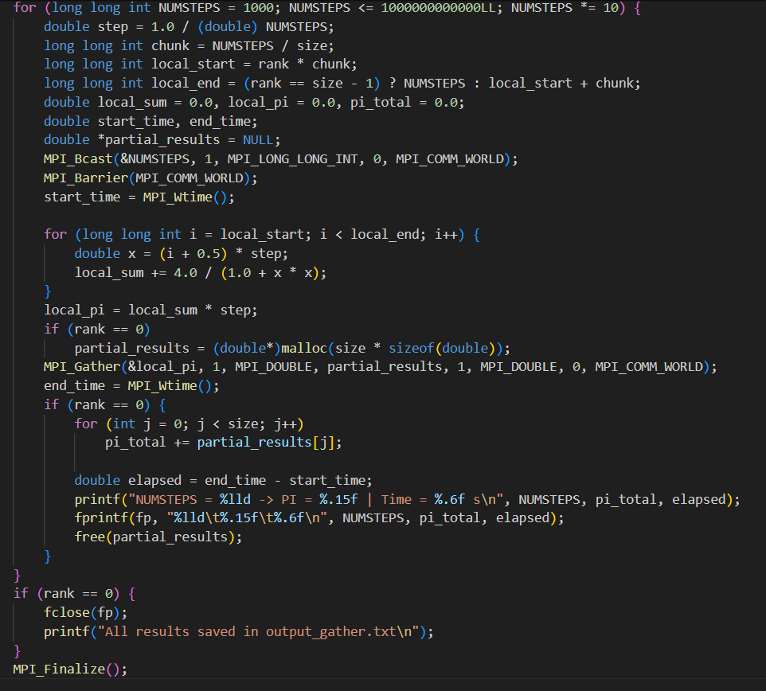
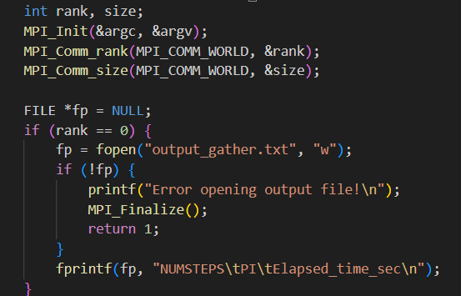
Methodology
Pi_Bcast&Gather Code explanation

Slide 8

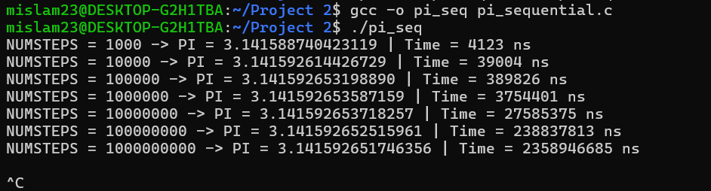
Results and findings
Run Sequential
Stuck after 10⁹
8

Slide 9
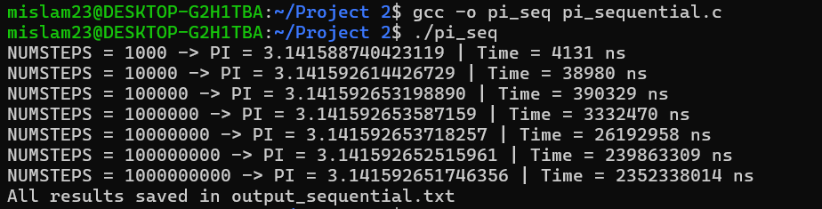
Results and findings
Run Sequential
Stuck after 10⁹
9

Slide 10
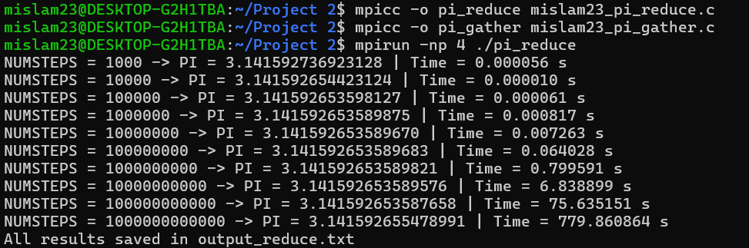
Results and findings
Run version1 (Reduce)
10

Slide 11
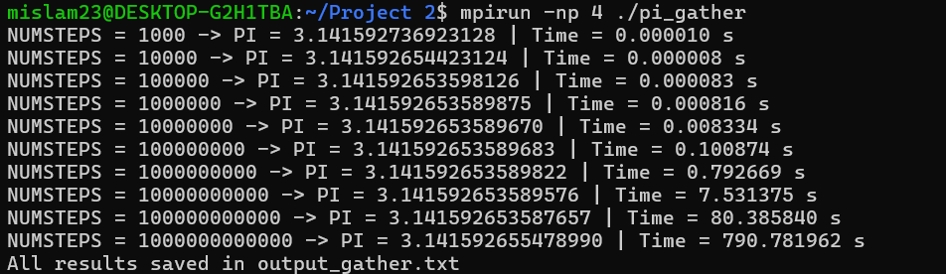
Results and findings
Run version2 (Bcast&Gather)
11

Slide 12
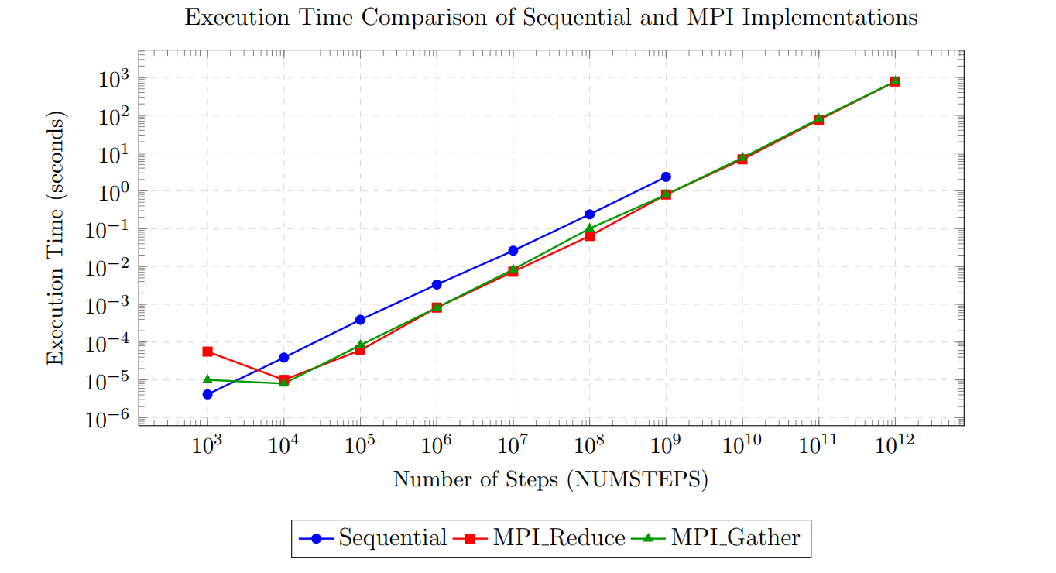
Results and findings
Execution Time Comparison of Sequential and MPI Implementations
12

Slide 13
Results and findings
Table 1: Result analysis
NUMSTEPS | Sequential (ns) | MPI Reduce (s) | MPI B&Gather (s) | Speedup (R) | Efficiency | Speedup (G)
10³ | 4.13 × 10³ | 0.000056 | 0.000010 | 0.07 | 1.8 | 0.41
10⁴ | 3.90 × 10⁴ | 0.000010 | 0.000008 | 3.90 | 97.5 | 4.88
10⁵ | 3.90 × 10⁵ | 0.000061 | 0.000083 | 6.39 | 159.8 | 4.70
10⁶ | 3.33 × 10⁶ | 0.000817 | 0.000816 | 4.07 | 101.7 | 4.08
10⁷ | 2.62 × 10⁷ | 0.007263 | 0.008334 | 3.60 | 90.0 | 3.13
10⁸ | 2.40 × 10⁸ | 0.064028 | 0.100874 | 3.74 | 93.5 | 2.38
10⁹ | 2.35 (s) | 0.799591 | 0.792669 | 2.94 | 73.5 | 2.96
10¹⁰ | — | 6.838899 | 7.531375 | — | — | —
10¹¹ | — | 75.635151 | 80.385840 | — | — | —
10¹² | — | 779.860864 | 790.781962 | — | — | —
SpeedUp and Efficiency Calculation

Slide 14
Conclusion
Execution time:
Sequential >> MPI_Bcast_Gather > MPI_Reduce

Slide 15

Discussion
Thank you so much….
15

